Slide 1

Career analysis of renowned Football player
Shailesh JAngam

Slide 2
OBJECTIVE
To analyze the dataset containing 3 files of goal scorers, results, and shootouts of International football teams worldwide since inception and derive some insightful information.
Data cleaning and exploration.
Plot some graphs to understand the data better

Slide 3
Understanding the Dataset
Purpose: The dataset captures detailed football match statistics, including scores, tournaments, and goal scorers, from 1916 to October 2024.
Key Features: Includes columns such as date, home_team, away_team, home_score, away_score, tournament, scorer, minute, own_goal and penalty.
Missing Data: Some columns like scorer and minute, had missing values handled using placeholders or statistical methods.
Analytical Potential: The dataset enables analysis of scoring patterns, player performance, match trends, and tournament comparisons.

Slide 4
Insightful Visualizations
Using python libraries such as matplotlib and seaborn

Slide 5
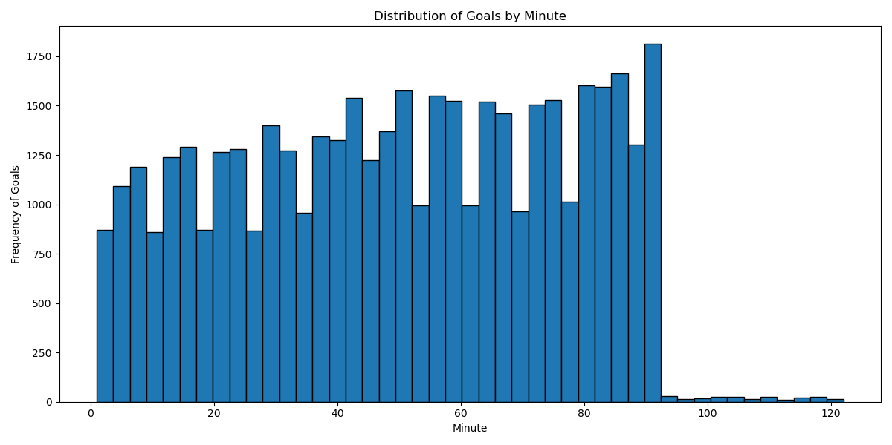
Details for the above Histogram:
Shows the timing of goals during matches. Mainly, towards the end of the match.
Peaks in the distribution reveal periods of high scoring intensity i.e. after 80th minute
This insight is valuable for identifying strategic moments within a game. This helps us understand that most of the teams score goals during the last 10 minutes of the match.

Slide 6
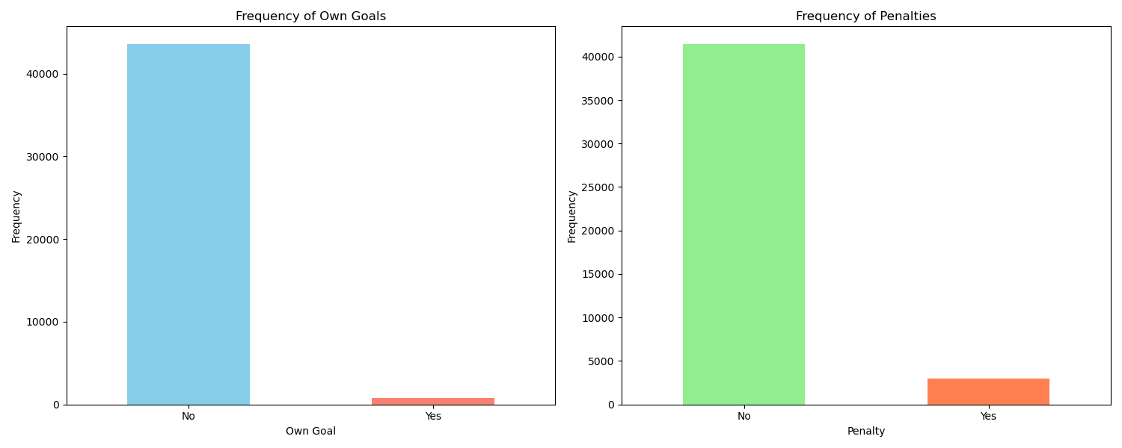
Frequency of Own Goals and Penalties:
Left chart shows the frequency of own goals, indicating defensive mistakes.
The right chart displays penalty goals and highlights special scoring instances.
Helps understand unique scoring events and team discipline.
The right chart also states that there are few fouls committed in the penalty box which is a danger zone.

Slide 7
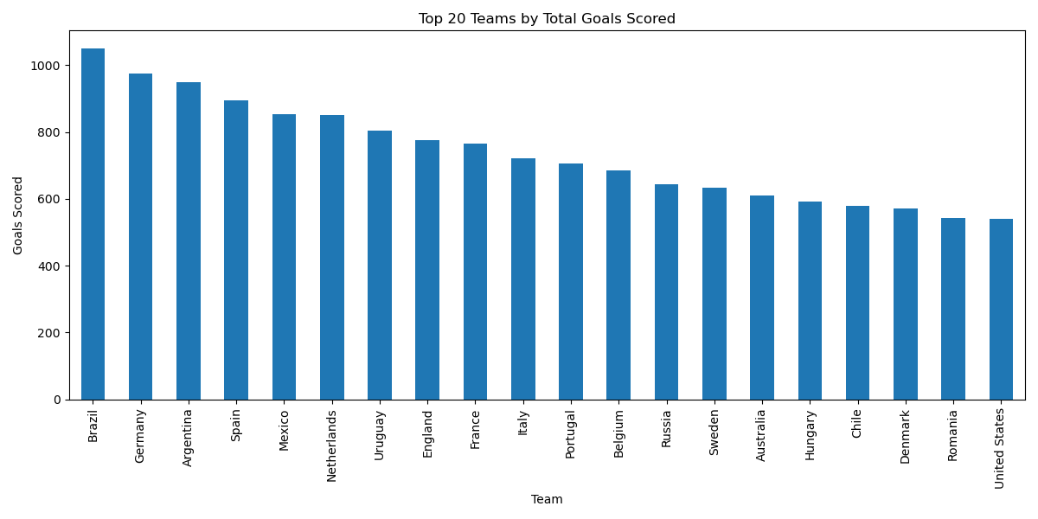
Team | Goal count
Brazil | 1051
Germany | 974
Argentina | 948
Spain | 894
Mexico | 852
Netherlands | 851
Uruguay | 804
England | 775
France | 766
Italy | 720
Portugal | 706
Belgium | 685
Russia | 644
Sweden | 633
Australia | 611
Hungary | 593
Chile | 578
Denmark | 571
Romania | 543
United States | 540

Slide 8
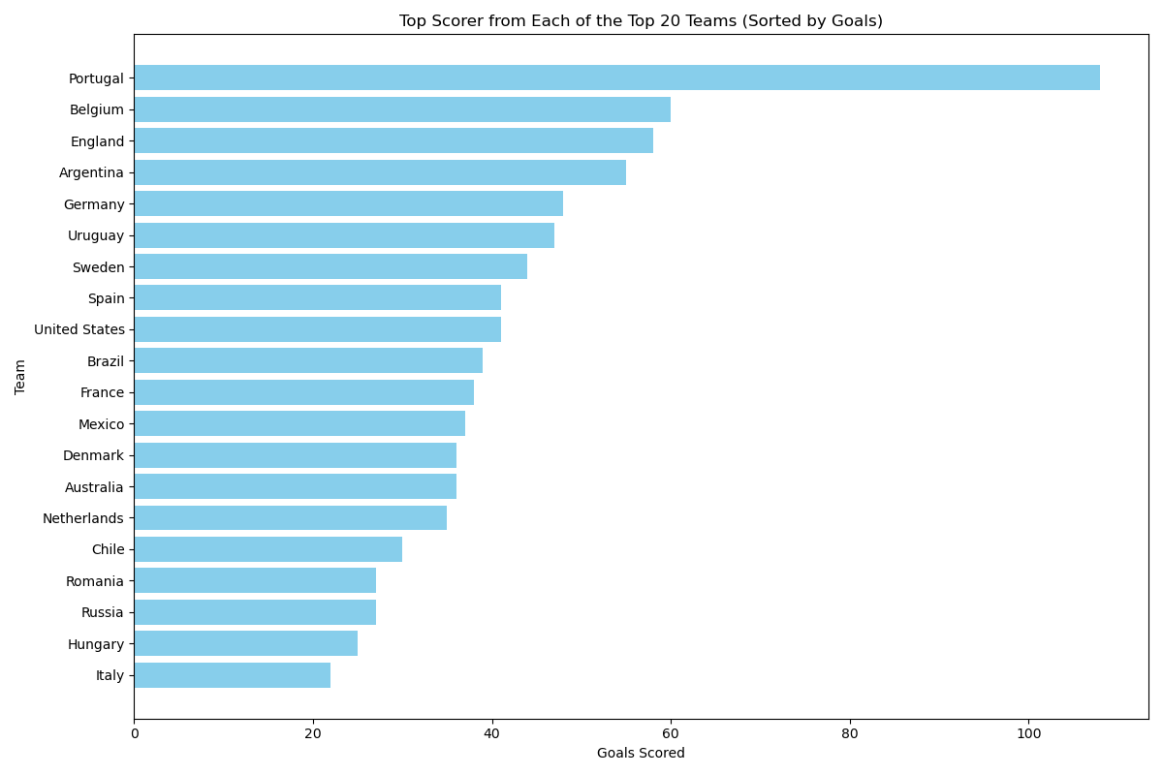
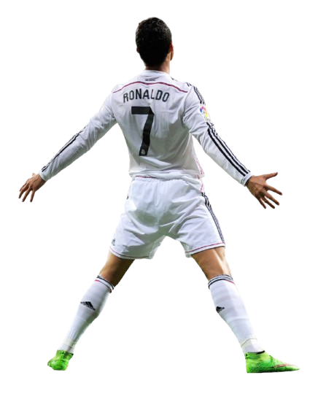
Team | Scorer | Goals_scored
Portugal | Cristiano Ronaldo | 108
Belgium | Romelu Lukaku | 60
England | Harry Kane | 58
Argentina | Lionel Messi | 55
Germany | Miroslav Klose | 48
Uruguay | Luis Suárez | 47
Sweden | Zlatan Ibrahimović | 44
Spain | David Villa | 41
United States | Clint Dempsey | 41
Brazil | Ronaldo | 39
France | Kylian Mbappé | 38
Mexico | Jared Borgetti | 37
Denmark | Jon Dahl Tomasson | 36
Australia | Tim Cahill | 36
Netherlands | Memphis Depay | 35
Chile | Alexis Sánchez | 30
Romania | Gheorghe Hagi | 27
Russia | Artem Dzyuba | 27
Hungary | Ferenc Bene | 25
Italy | Filippo Inzaghi | 22
SSSSUUUUUUUUIIIIIIII

Slide 9
Key Insights from the previous slide
Top Scorer: Cristiano Ronaldo leads with 108 goals, showcasing his pivotal role in Portugal's offense.
Close Contenders: Romelu Lukaku (60 goals for Belgium) and Harry Kane (58 goals for England) highlight individual brilliance in team success.
Consistent Legends: Lionel Messi (55 goals for Argentina) and Miroslav Klose (48 goals for Germany) stand out for their sustained excellence over the years.
Balanced Offense: Brazil (Ronaldo - 39 goals) and France (Kylian Mbappé - 38 goals) demonstrate team-oriented scoring with strong individual contributions.
Emerging Stars & Veterans: Kylian Mbappé (38 goals for France) represents the future, while veterans like Clint Dempsey (41 goals for the U.S.) and David Villa (41 goals for Spain) underline their lasting impact.

Slide 10
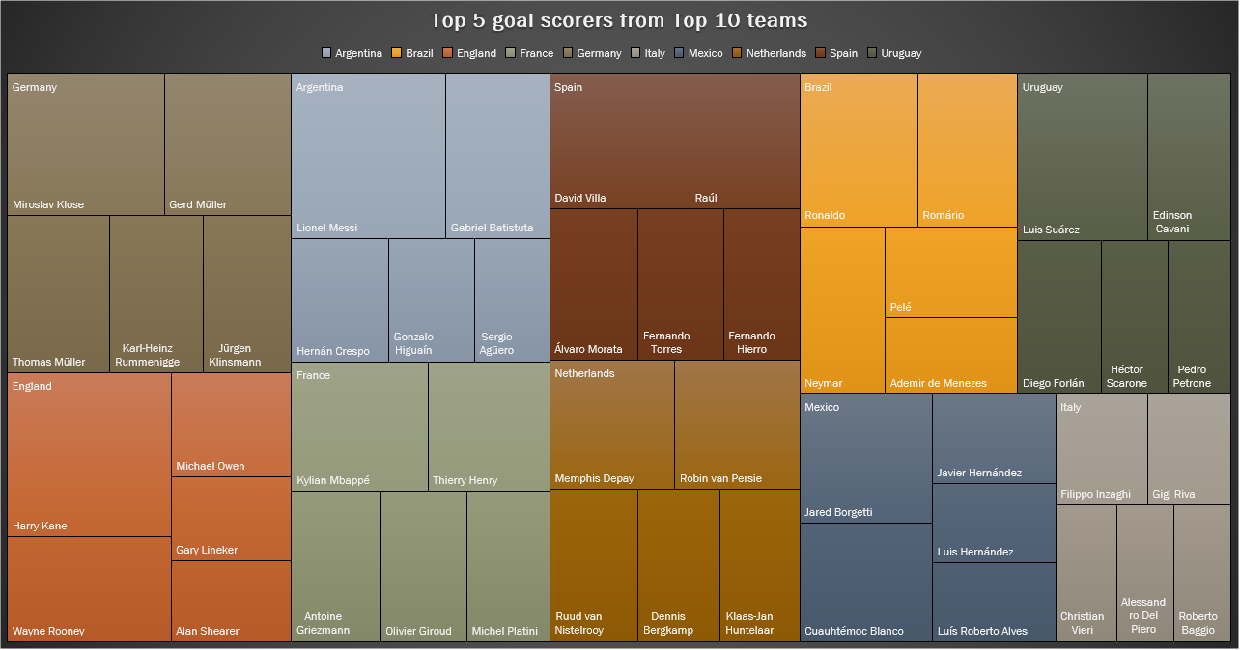

Slide 11
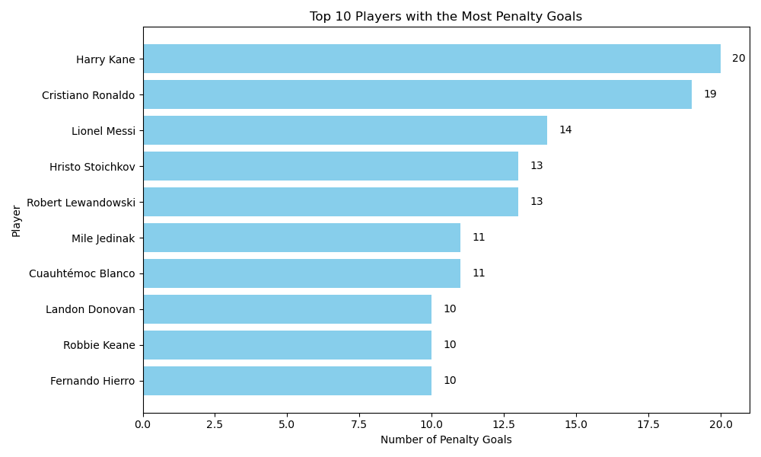

Slide 12
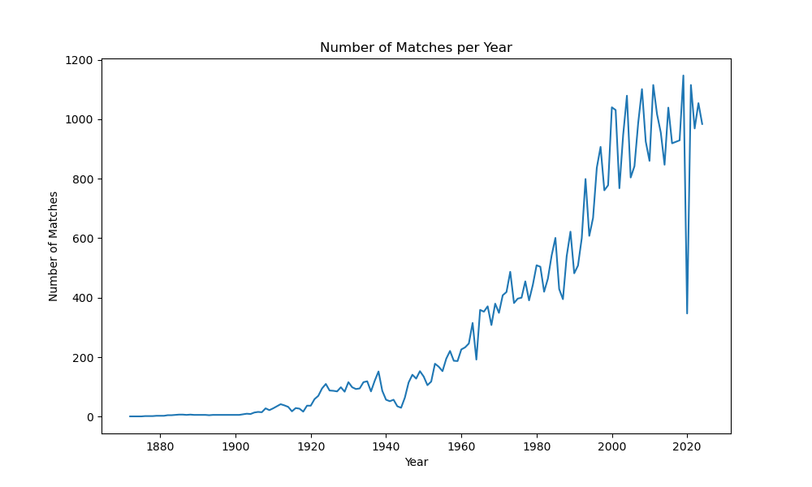
Shows the trend in the number of matches over the years.
Peaks indicate years with more tournaments or popular sporting events.
Significant dips indicate periods of global events like wars, pandemic or other disruptions for eg. Covid-19 Pandemic during the year 2020

Slide 13
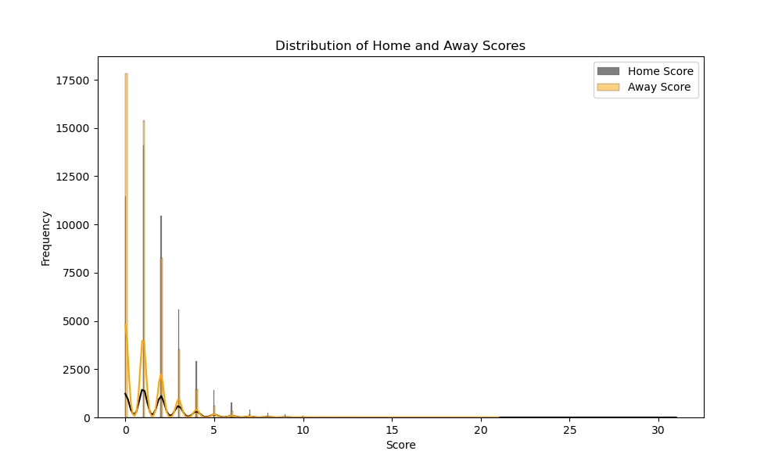
Displays the frequency of different scores for home and away teams.
Observing higher scores for home teams might indicate a 'home advantage'.

Slide 14
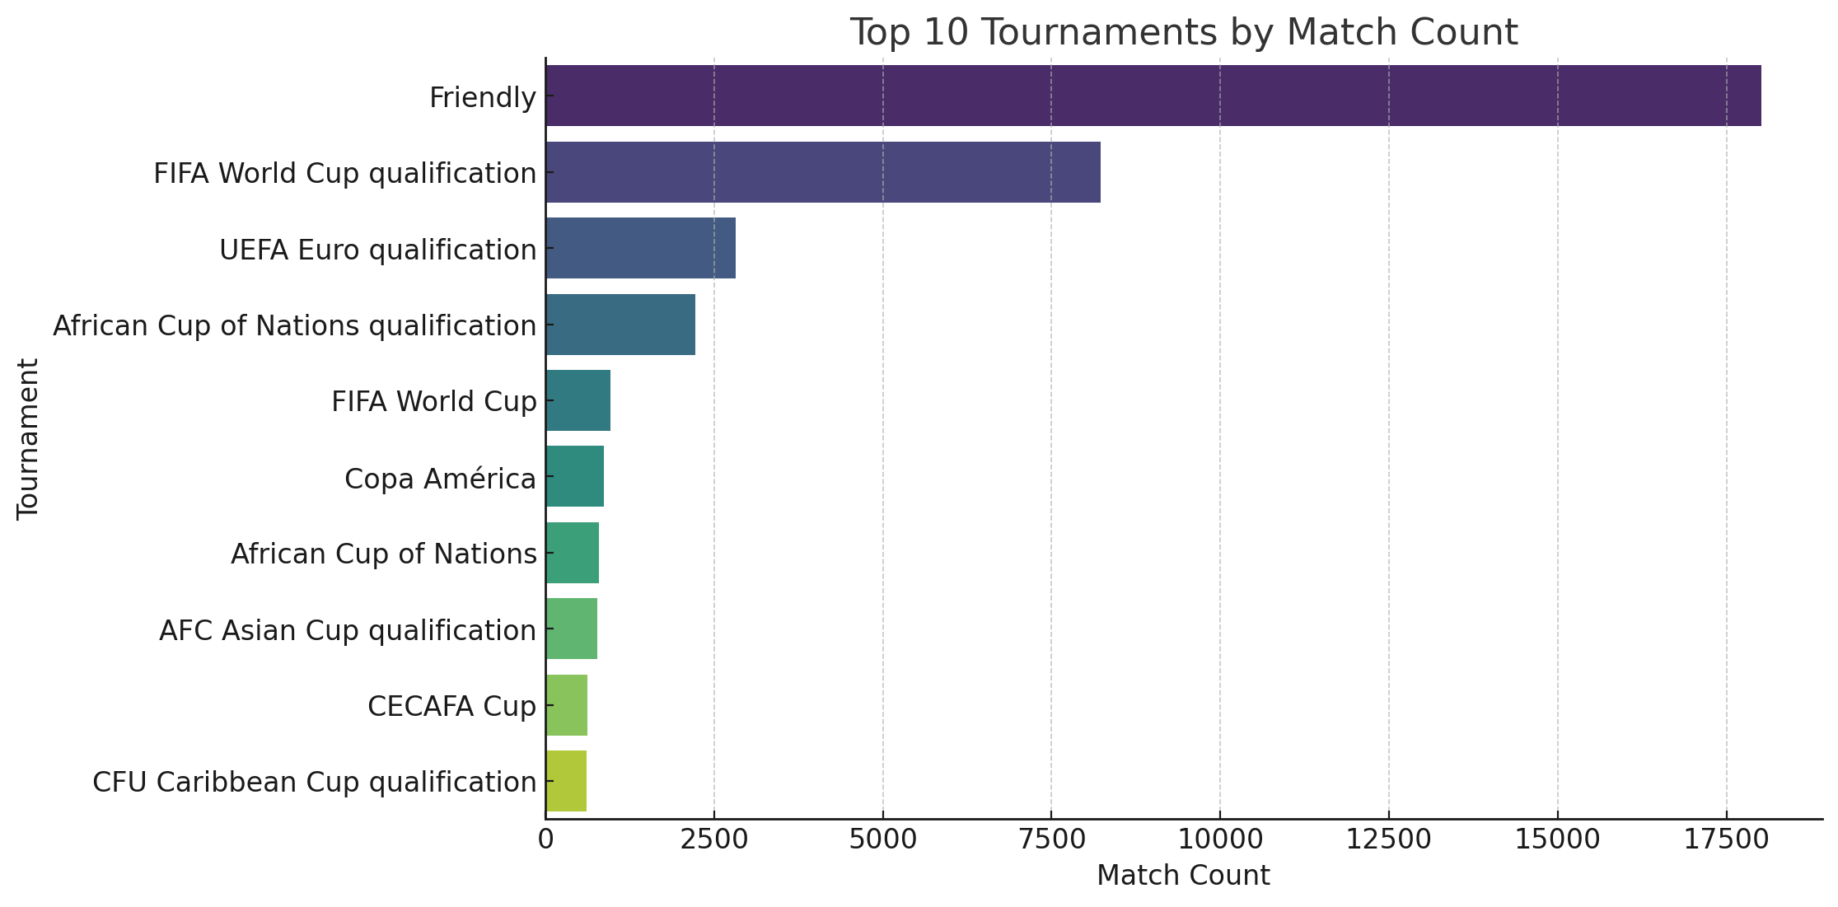
Identifies the tournaments with the highest number of matches.
Useful for understanding which tournaments are more frequent or popular.
As the graph says most of the matches are Friendly and qualification matches for popular competetions such as FIFA world cup and UEFA Euros."

Slide 15
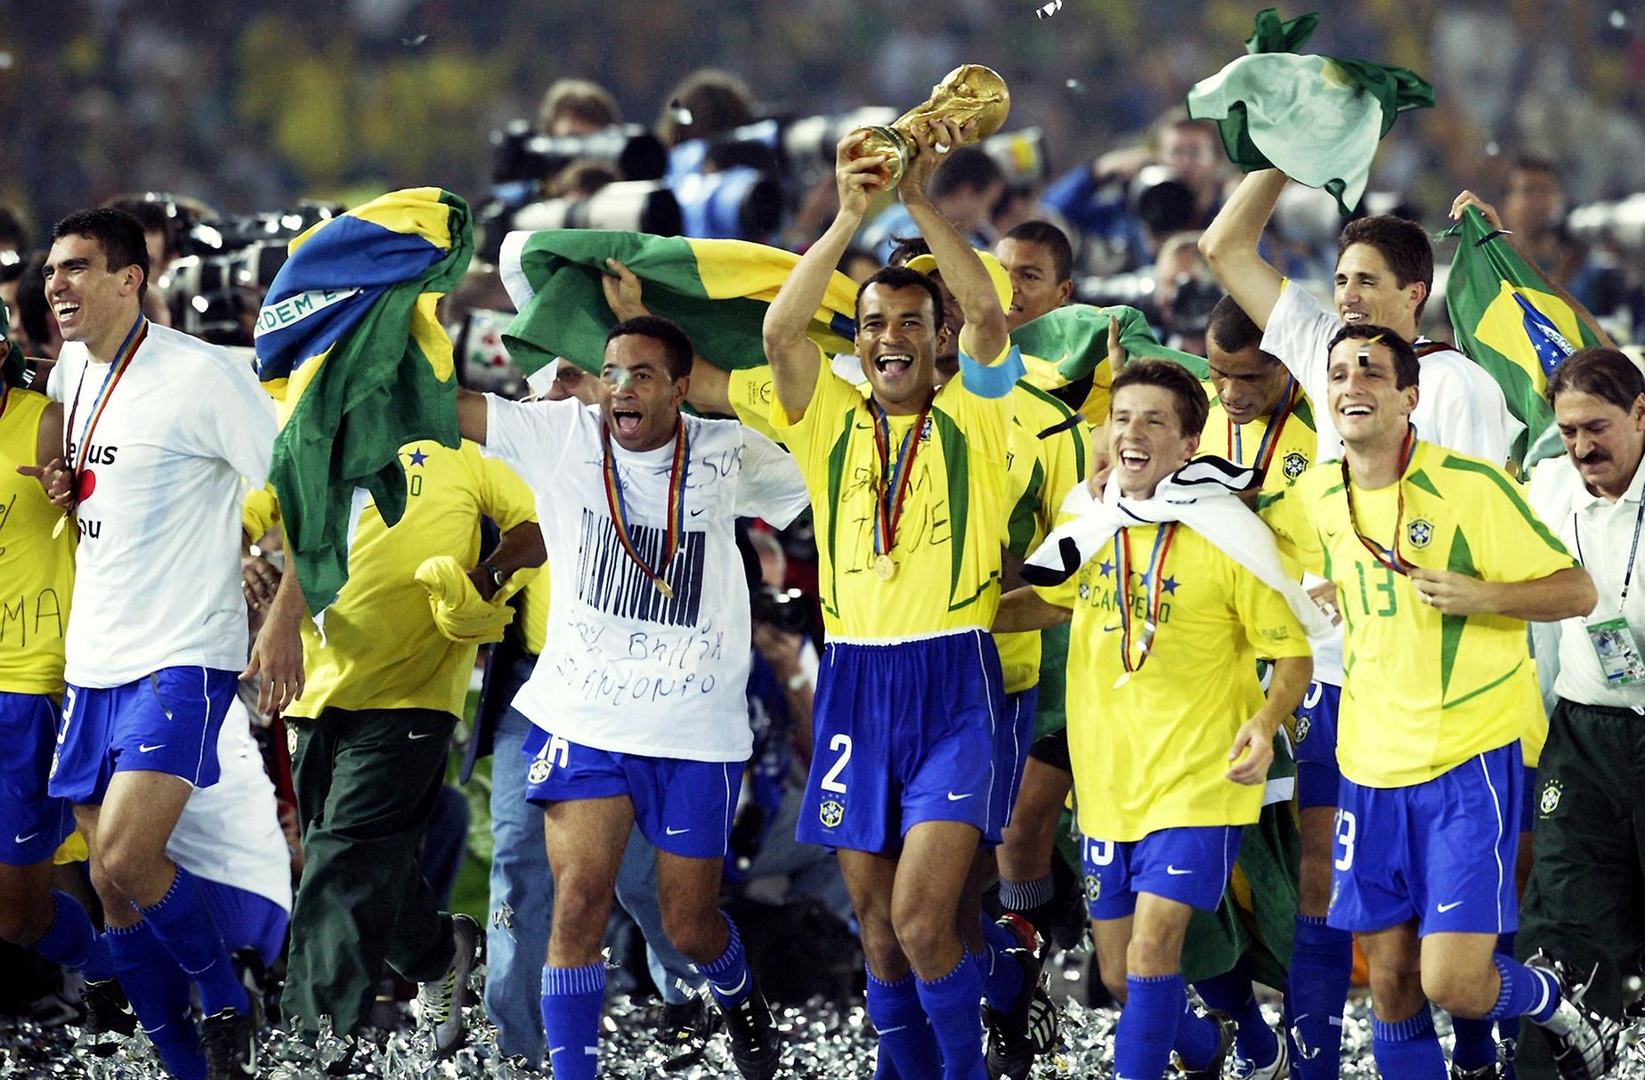
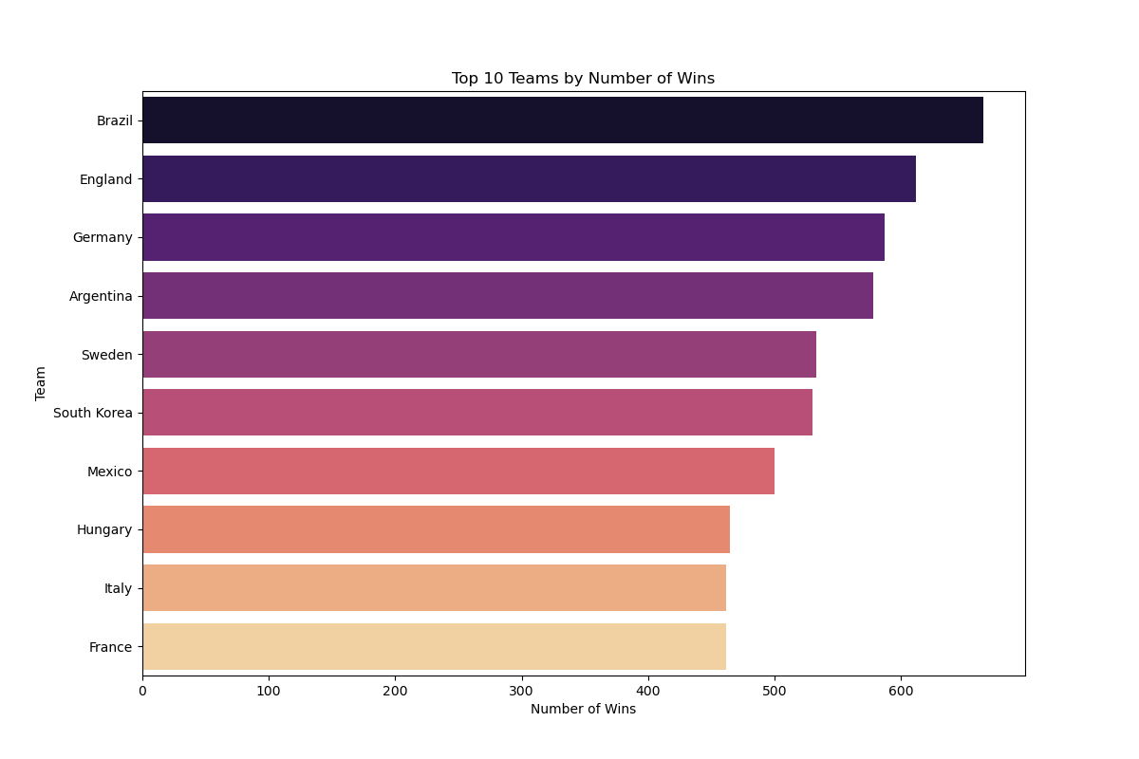
Team | Wins
Brazil | 665
England | 612
Germany | 587
Argentina | 578
Sweden | 533
South Korea | 530
Mexico | 500
Hungary | 465
Italy | 462
France | 462
Highlights the top 10 teams with the most wins across all matches.
Helps identify consistently strong teams in the dataset. In this case these are the top 10 strongest teams of all time.
Total wins include both home and away victories for each team.
This Photo by Unknown Author is licensed under CC BY-NC-ND

Slide 16
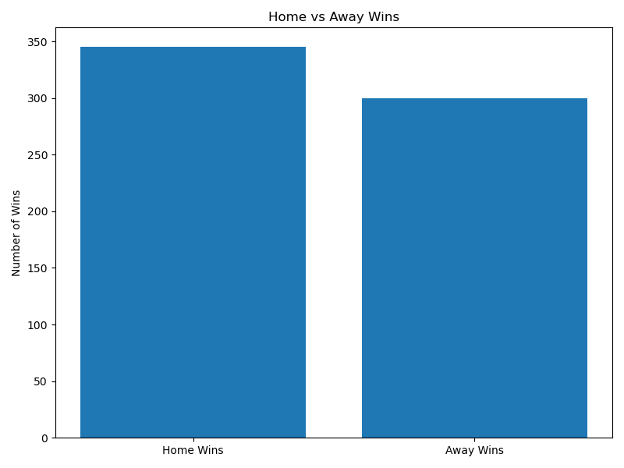
The above chart shows the number of wins for home versus away teams.
The chart clearly states that the number of wins is more as compared to away wins and also indicates the Home advantage during the shootouts

Slide 17
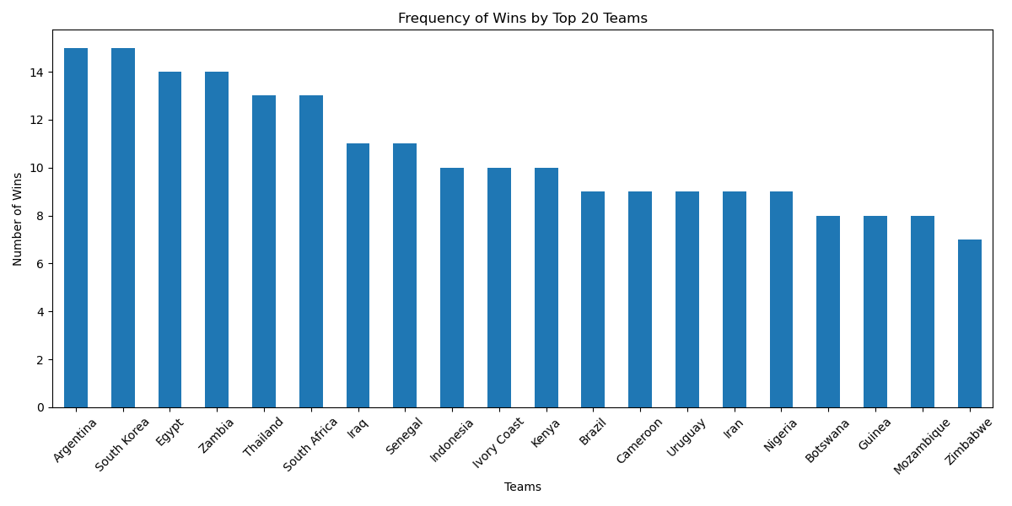
The bar chart shows the number of shootout wins by each team (top 20)
This highlights which top 20 teams have been the most successful team in the shootouts historically.

Slide 18
Analizing the career of Cristiano Ronaldo
Shailesh JAngam

Slide 19
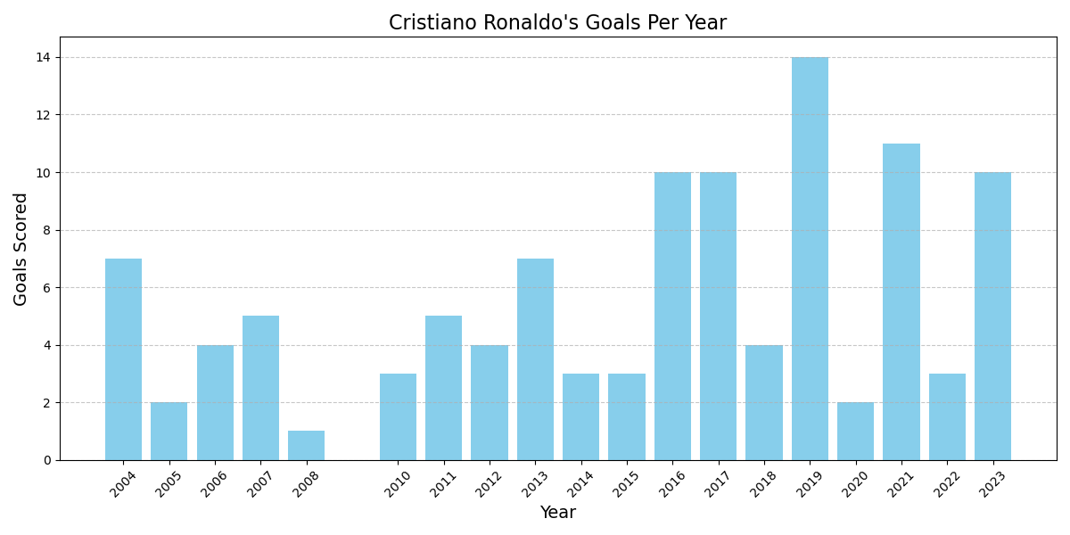
As we can see from the visualization, Ronaldo has performed very well for Portugal’s National Football Team in recent years; his best years are 2019 and 2021.
The total number of goals scored by Cristiano Ronaldo is 108 in International Football.

Slide 20
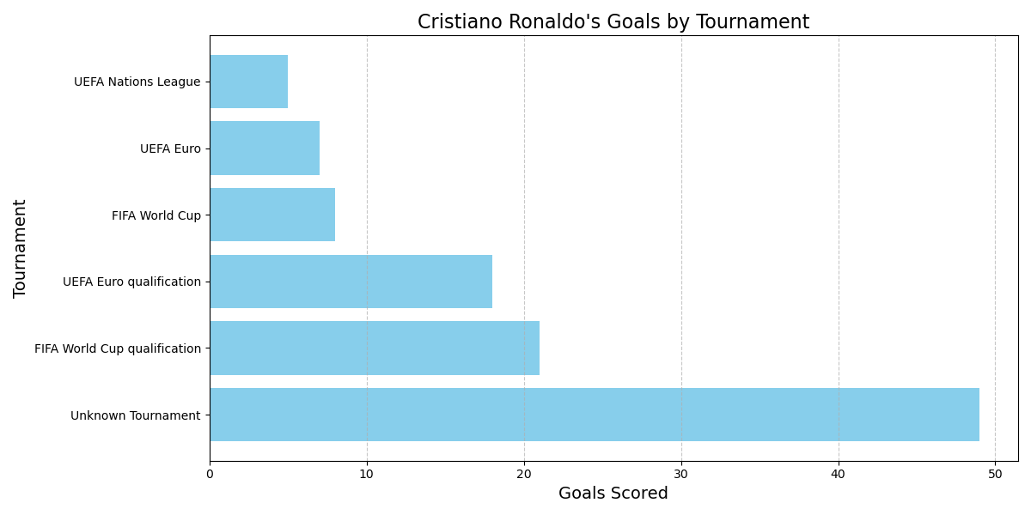
‘Unknown Tournament’ may indicate Friendly or non-classified matches.
Ronaldo’s performance has been scoring goals in the top tier matches such as the FIFA World Cup and UEFA Euro qualifications.

Slide 21
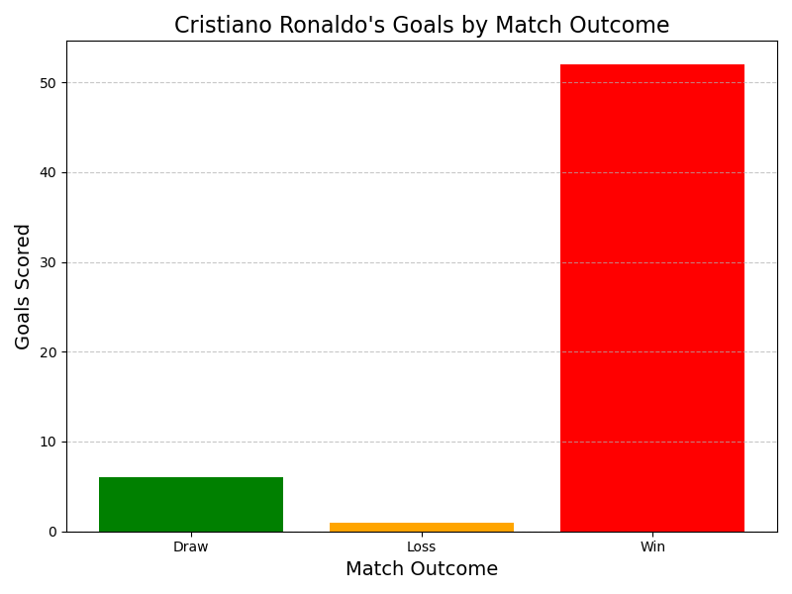
The above visualization clearly states that the presence of Cristiano Ronaldo in the matches where he has scored goals turns out to be positive results for his National Football Team.
Ronaldo has scored in more than 50 matches where the results were in the team’s favor.

Slide 22
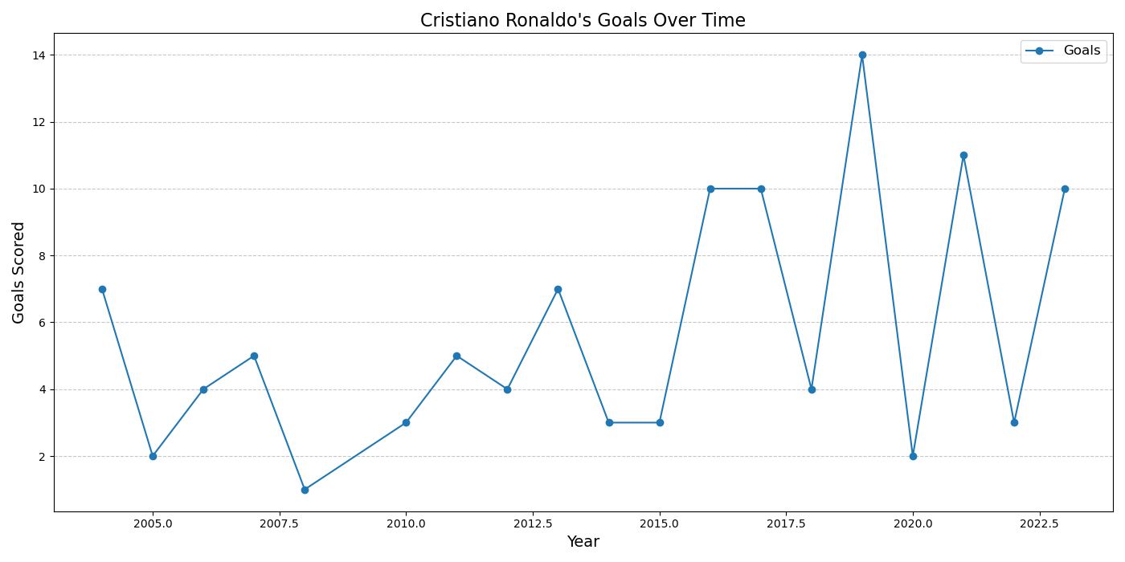
Overall Trend: Ronaldo’s goal count showed steady growth during the early 2010s, reaching a peak in 2016 when he also won the UEFA Euros his first International Trophy.
Transformational Trend: Between 2015 and 2016, there is a noticeable jump in his performance.
Notable Peak: In 2016, Ronaldo scored 10 goals, the highest for a single year in the data set.

Slide 23
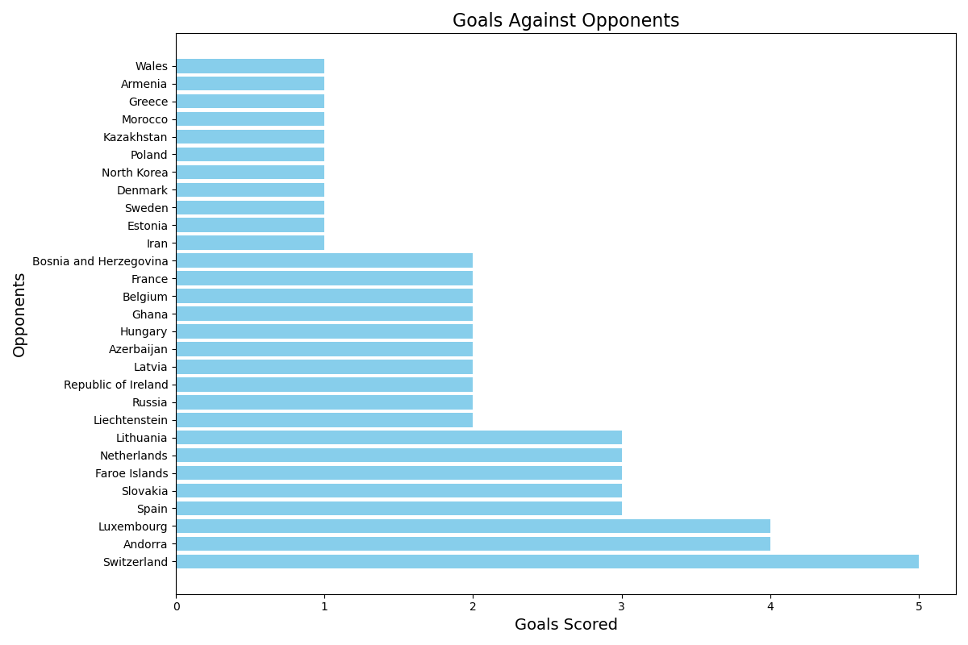

Slide 24
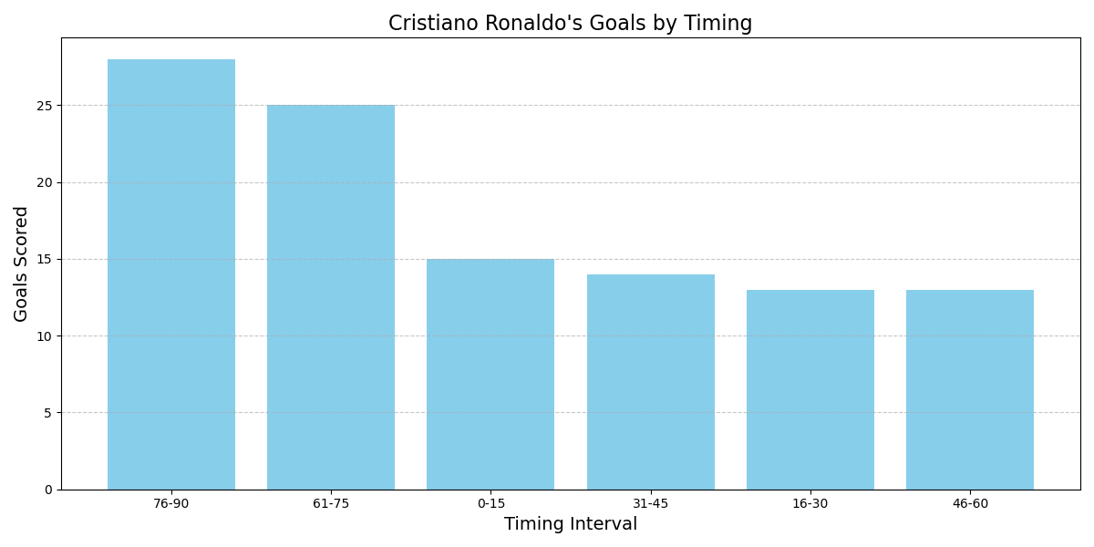
As per the data Ronaldo has scored in every minute of the i.e. from 0 to 90 mins.
The above visualization shows that the majority of the goals scored by him is after the 60th minute, which also indicates his fitness and passion for the game.
3. Ronaldo has scored 53 goals during that time which is also considered as crucial minute of the game.

Slide 25
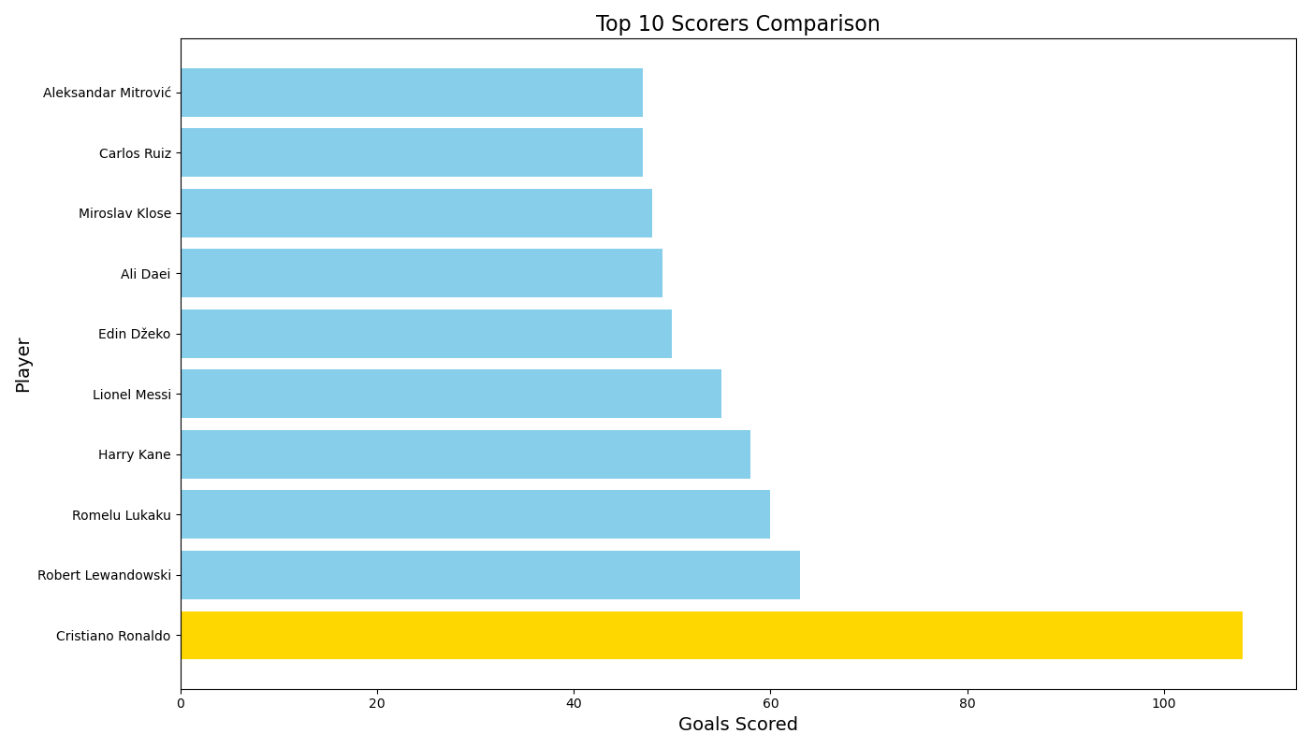
Ronaldo has scored 45 goals more than the second-best goal scorer in International Football which shows his dominance throughout the years.
Ronaldo has surpassed the records which were previously held by Legends of the game such as Ali Daei and Miroslav Klose.

Slide 26
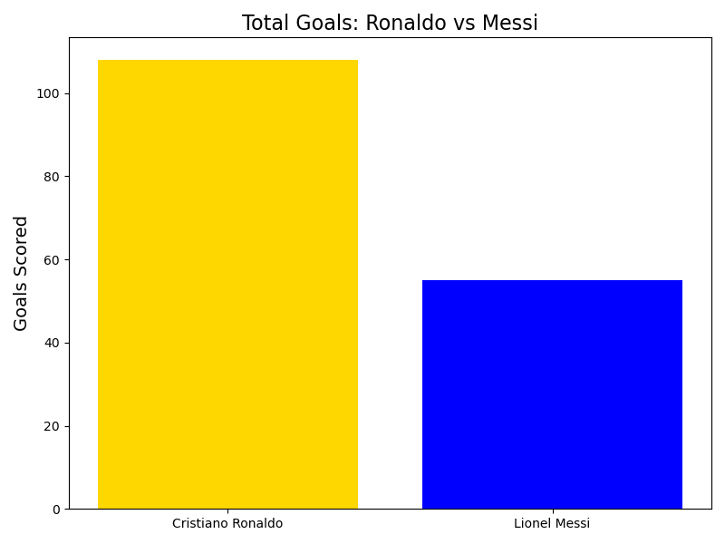
Here is the goal comparison of the greatest rivalry this game has ever seen Cristiano Ronaldo vs Lionel Messi.
The visualization evidently showcases the number of goals scored by each of the greatest football players ever.

Slide 27
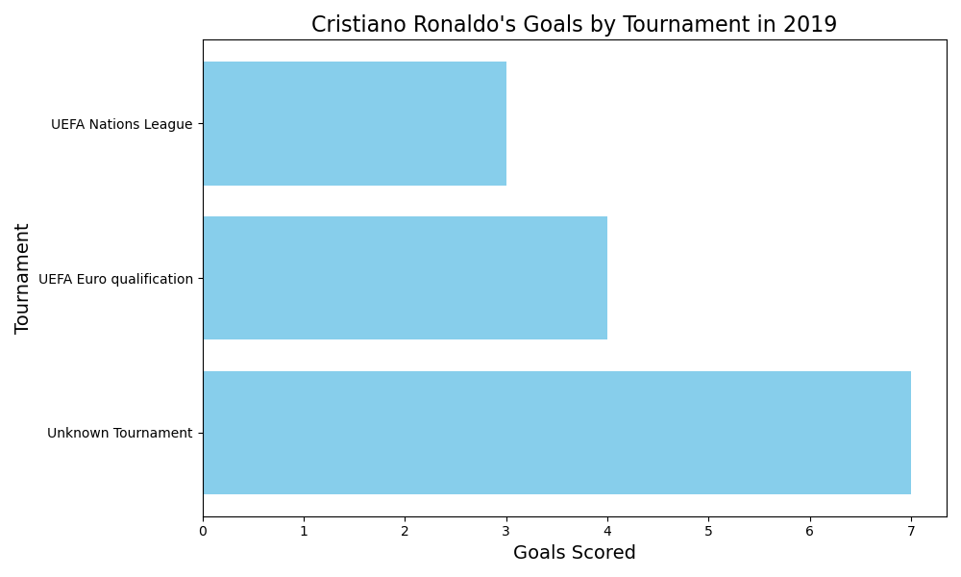
As the data says, 2019 was the best year for Ronaldo in his International Football career scoring 14 goals.
He has had a remarkable record in UEFA competitions throughout his career.
2008 being the worst year of his International career scoring only 1 goal.

Slide 28
“Data tells a story, but it’s the analysis that brings it to life.”
- Anonymous

Slide 29
THANK YOU

